Slide 1
Agenda
Overview
Test Plan
Findings
Expectation vs Satisfaction
Recommendations & Lesson Learned
Q&A

Slide 2
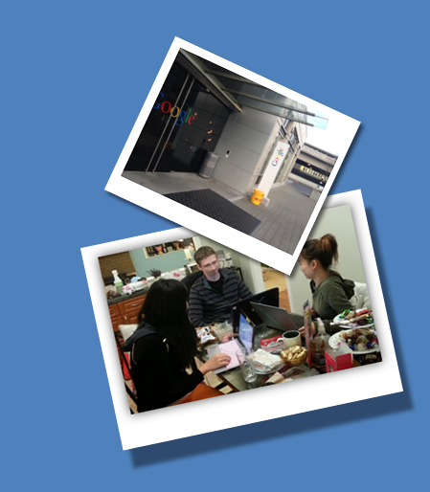
Overview
Product Introduction
Developer Console
gsutil
Test Plan
Method
Participant Profiles
Testing Plan

Slide 3
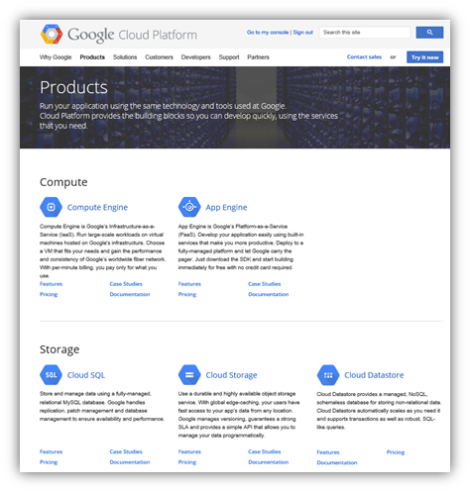
Google Cloud Platform
Notes:
Google Cloud Storage
Google Cloud Storage is part of the Google Cloud services platform object storage service designed for high availability.
There are generally two ways to access and manage data on Google Cloud Storage. Access can be done through a web application called Google Developer Console or by use of the command line tool called gsutil.

Slide 4
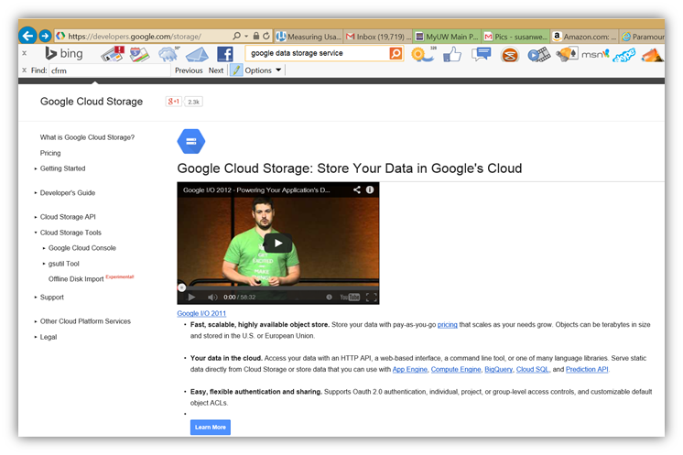
Notes:
Cloud Storage is part of the Google Cloud Platform and it is one of the services offered to access and manage application data.

Slide 5
Google Cloud Platform
Google offers two tools:
Developer Console Web UI Component
gsutil
Python Application Command Line
Notes:
Cloud Storage is part of the Google Cloud Platform and it is one of the services offered to access and manage application data.

Slide 6
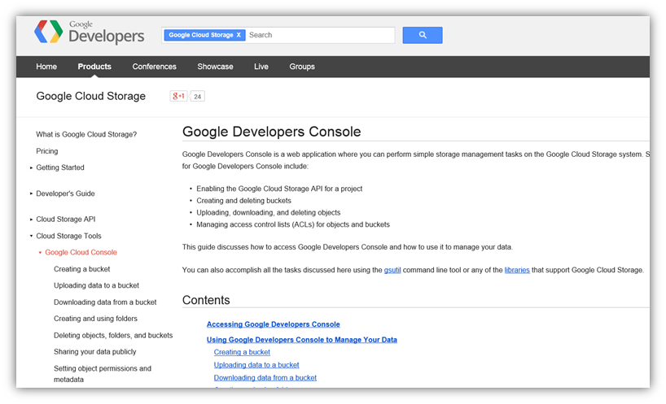
Product Introduction

Slide 7
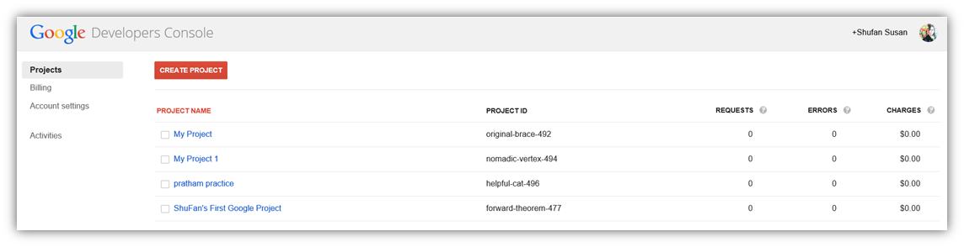
Product Introduction
Developer Console - Web UI Component

Slide 8
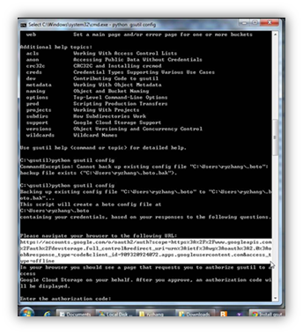
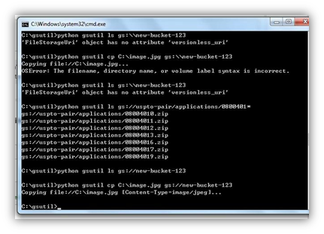
Product Introduction
gsutil - Python Application Command Line

Slide 9
Purpose
Google offers two tools:
Developer Console: Web UI Component
gsutil : Python Application Command Line

Slide 10
Participant Profiles
8 Developers who understand how to use command lines
(developers/testers/TPM/DBA, small businesses, students, and startup companies)
Users Category 1: Experienced
(Users who use or have used cloud storage services products)
Leverage discovery on how the features and tasks work
Users Category 2: Novice
(Users with minimal or no exposure to any cloud services)
Gain insights of those who are new to the cloud experience; segment represents similar users who support small business and startup companies
Notes:
1. Medium to High experience level with command line. / 2. Have some basic command line capabilities.
Recruited twelve developers and successfully ran user tests with eight developers with command line capabilities.(we had more but due to schedule conflict and illness dropped to 8. Maybe even remention as lesson learned to arrange for more than you truly want. Since 8 was are goal. but if we had stopped at 8 we would not have them.)

Slide 11
Method
Baseline Measurement Research by Diagnostic Method
Use within-subjects design
Conducted 1.5 to 2.5 hours sessions
Think Aloud Protocol
Understand the thought process of a subject as participants use a product
Capture Impression pre/post task
5E’s of Use: Effective, Efficient, Engaging, Error Tolerant, Easy to Learn
Techsmith Morae Software
Record participants’ facial expression and the task
Notes:
Capture Impression pre/post task for Developer Console/gustil.

Slide 12
Testing plan
Survey Questions (online)
Online screener to assess experience level of participants
Pre-Test Questions (5min)
Qualitative data about the participants’ experiences
Introduction to the Session (5min)
Overview of the test, consent forms, the task description
Tasks (120min)
Each participant performed 13 tasks: five for Developer Console and eight gsutil.
Post-Test Questions (10min)
Use SUS for measuring participants’ satisfaction level
Open ended Questions (10min)
Inquire overall satisfaction/dissatisfaction and suggestion
Notes:
Pre-task inquire with 5E’s of Use on expectations for Developer Console and again with gsutil sections.
Collect data about task success and error rates
Post queries for Developer Console and Post gsutil sections with 5E’s of Use.

Slide 13
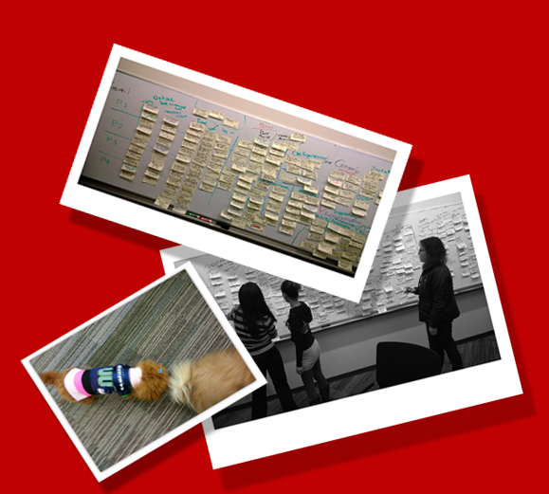
Findings
Console
UI
Documentation(Concept/Terminology)
Functionality
gsutil
Output/Messages
Installation
Documentation
Configuration

Slide 14
Positive Findings
Five participants had a positive experience with the Basic Delete function (worked to delete an item). They added that the copy and move features were standard on gsutil only.
Developer Console:
Three shared that adding emails to permissions was straightforward on the developer console and “able to add email to the account…”
Two highlighted Developer Console homepage that they were “glad to see access on API resource types and felt it was an important reference.”
gsutil:
Two indicated, “commands in gsutil were standard in comparison with other developer tools

Slide 15
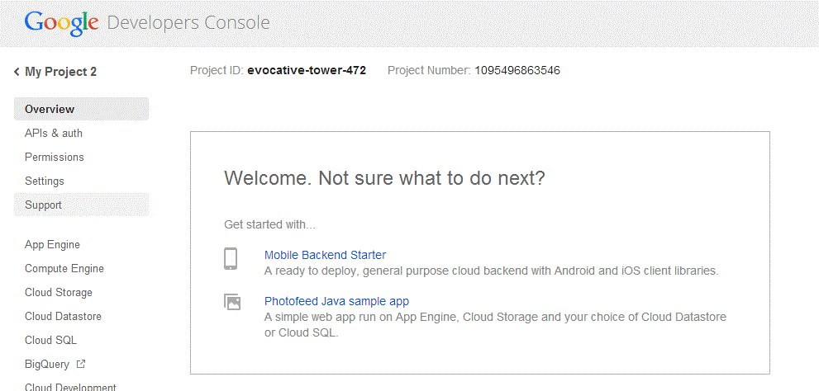
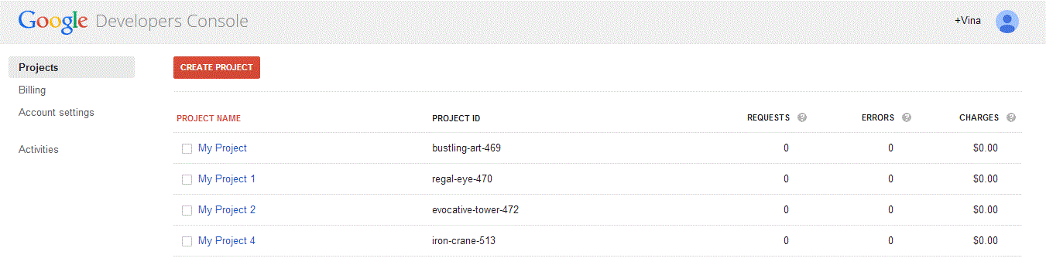
UI
UI Navigation actions
• No indication of location of the user on the UI.
• No obvious link to take user back to previous steps.
Information Architect
• Overview Page - 5 / 8 Feedback.
• Information presented irrelevant.
“Overview popup is insulting”
No navigation to go back to main menu or previous page.
Irrelevant information displayed
Notes:
Information Presentation & Layout - Overview
Information and content presented on the page are not relevant to the topic, e.g. Overview page - no Overview information about the product
Account and billing sections
UI for Sharing is not intuitive
Clicking on a Project brought user back to the Overview page.
Contents displayed on the link are irrelevant to the topics

Slide 16
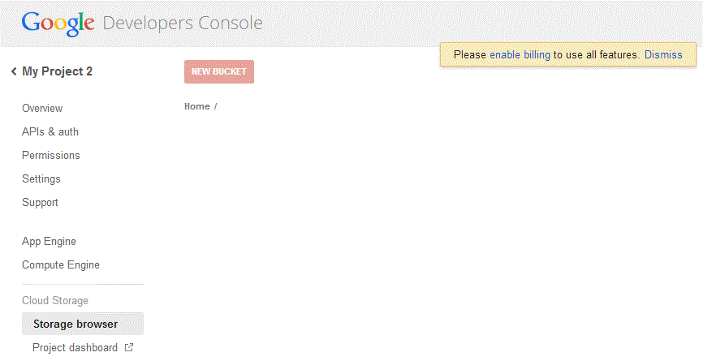
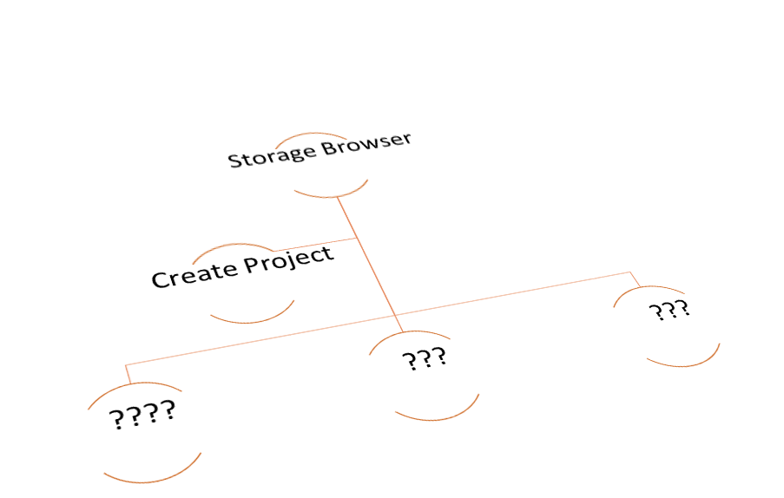
UI
Presentation & Layout
No design hierarchy or mapping hierarchy
Project indication is here instead.
No structure on the layout. e.g. Storage Browser-->Project--> Bucket

Slide 17
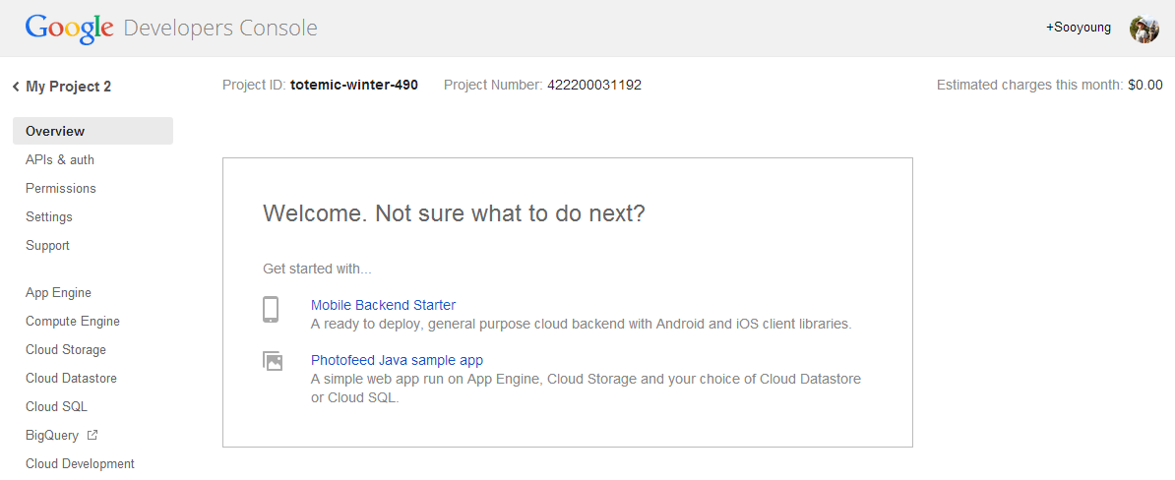
Documentation
Intuitive issues, lacks documentation and explanation on language uses
Needs online help and user guide with examples to explain
.
“Did not provide details on overview” (P7, P4, Q1)
Overview
“The Console is not
self explanatory; it is complex.” (P4)
Notes:
Overview section to display information about the product/tool
Overall Documentation Needs
Intuitive reliance on locatable documentation. (All participants relied on Google Search or past exp.)
Provide quick explanation on language use.
“Needs online help linked and user guides with examples to explain the Developer Console.”
Sections labeled location for documentation yet no material to ease users learning, e.g. “Overview.”

Slide 18
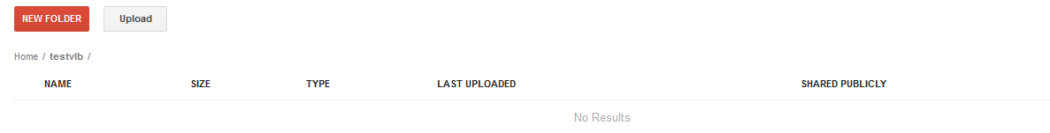
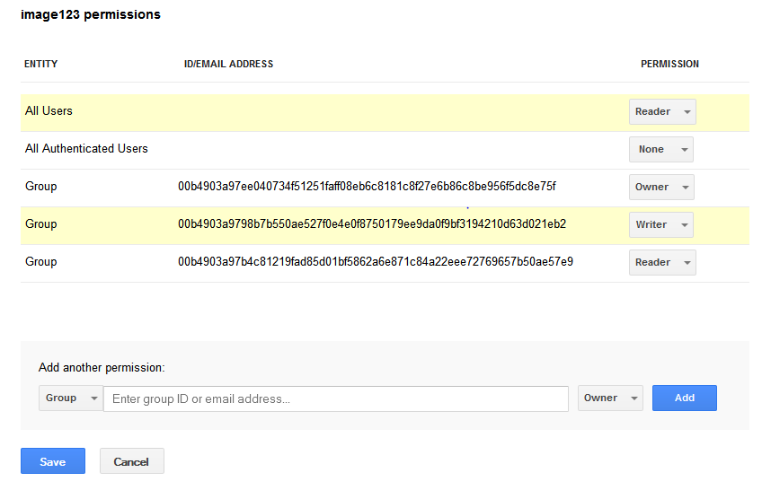
Documentation
Shows can share publicly but does not indicate when private nor defines.(P6)
Image permission closest to public/private mention of Authorized Users (P7,P2)
Permission Not Defined Documentation needs to explain difference in permission roles and levels explain how works with members and/or objects

Slide 19
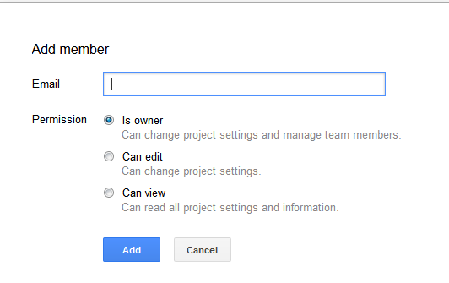
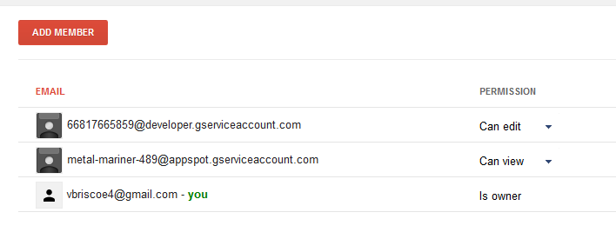
Documentation
Adding members it is unclear if private or public from options:
“edit,” “owner,” or “read” (P7, P2)
"Private is confusing, ambiguous, or what does it mean? (P5, P6, P7, P8, Q5)
Does not indicate public or private option. (P7)

Slide 20
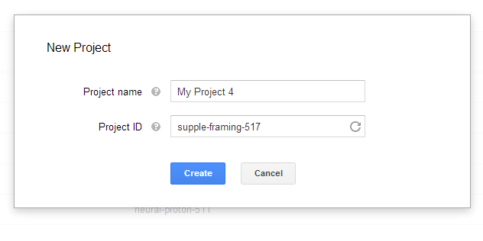
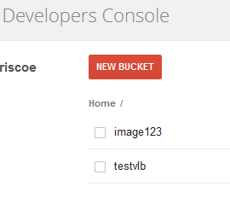
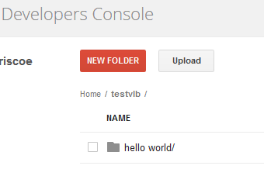
Documentation
Terminology
Nomenclature, commonality and learnability play key role in success
Bucket, Folder, Project, File needs defining and order, participants question naming structure
Naming of the Project was limited, navigation was a problem, the hierarchy was not understood (P6, P8)

Slide 21
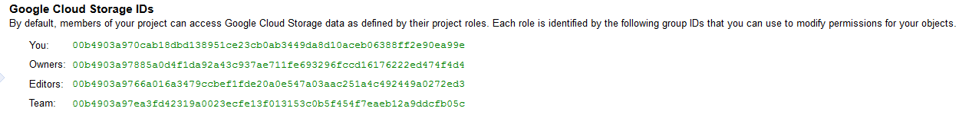
Documentation
Project ID & Terminology
commonality and learnability play key role in success
.
"Why not autoload Project ID’s; what purpose are they editable? Instead tool should recognize prior inputs in file names.” (P6)
“Naming needs to be consistent between console and gsutil for Project ID's (P7)
Not sure how to create a project (P5) Project ID’s are weird (P8,P3)

Slide 22
Functionality
Object Permission.
Confusing definition for sharing and setup.
Billing blocks further action
Billing pop-up

Slide 23

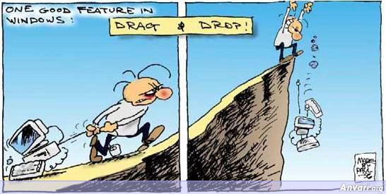
Functionality
User Interaction
How to do drag and drop in Google Docs
Notes:
Long ProjectID and Project Name
Confusing definition and use of ProjectID
There’s no connection between Project and a Bucket: except everything you do is under a bucket, e.g. upload files, download files, etc. Bucket functions like a folder that contains all of the data, and Project is empty.
For the tasks when we had to copy and share an image with a project member.

Slide 24
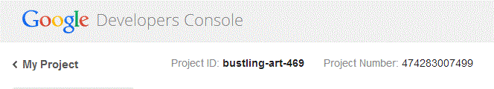
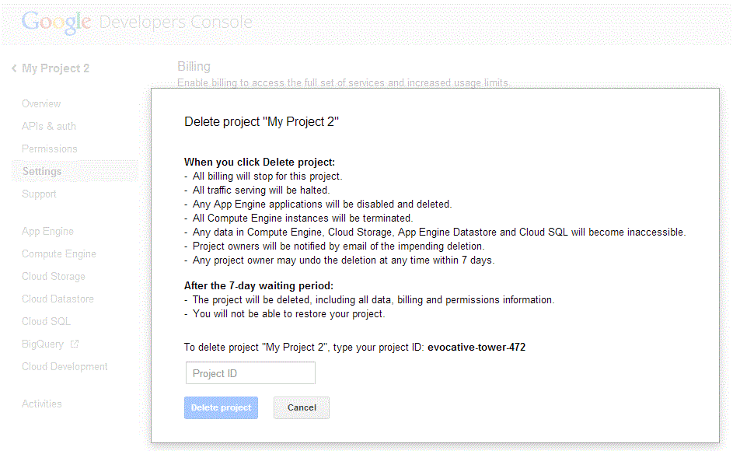
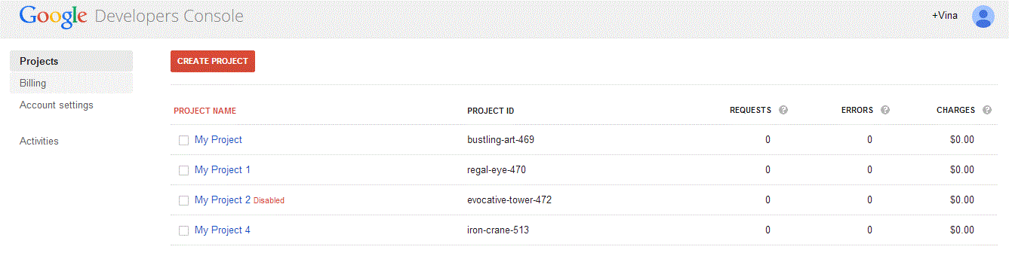
Functionality
Why user has to know Project ID if you are deleting the project already?
.
Long project ID and name
Project is not removed from the list; only disabled
Project ID input field
Notes:
Can’t delete a project w/o entering a ProjectID first? If you have multiple Project IDs, what happens to those Project IDs???
Long ProjectID and Project Name
Confusing definition and use of ProjectID
There’s no connection between Project and a Bucket: except everything you do is under a bucket, e.g. upload files, download files, etc. Bucket functions like a folder that contains all of the data, and Project is empty.

Slide 25
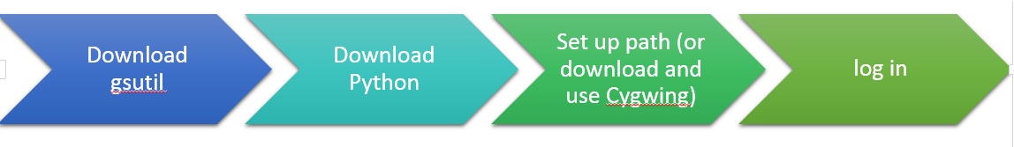
Installation SW
Installation of gsutil
Python
Log in
“I feel happy to finish and
successful at verifying
installation” P5

Slide 26
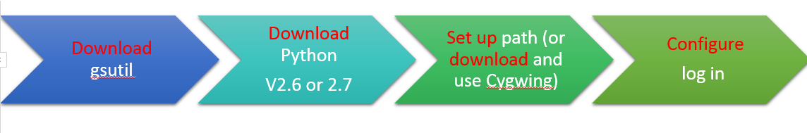
Installation SW
Cumbersome to Install: Complicated process to install
P4 couldn’t set up the path
P1 Gave up
P3 Gave up
6 out of 8 participants installed wrong version of Python
Notes:
So many action involved: Too many steps

Slide 27
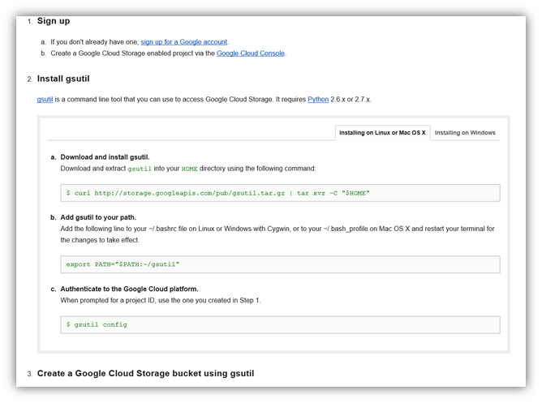
Installation gsutil
Instruction is not clear.
P2 Command to install not found
P6,P7: Use console to verify installation
P3,P4, P7: documentation problem: no command line for log in
Notes:
The instruction looks easy to install, but it does not.
It does not contain detailed information on how to do it fast. There are long hyperlink requires user to copy and past and use several windows to do the installation.

Slide 28
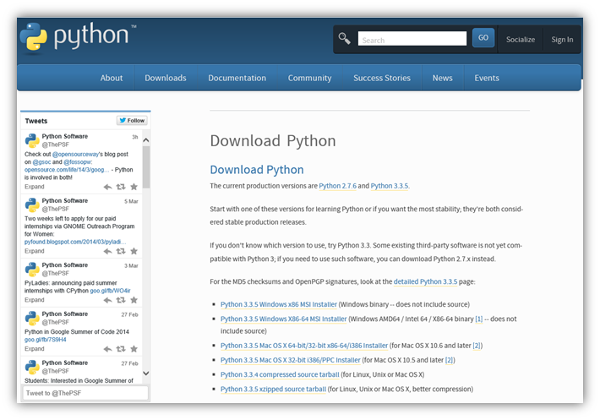
Installation Python
P7: “hard to find the old version”

Slide 29
Installation login
Cumbersome steps: the link to find authorization code.
No instruction and command line for how
to log in.
P4: “It is lousy, not a good UX… “

Slide 30
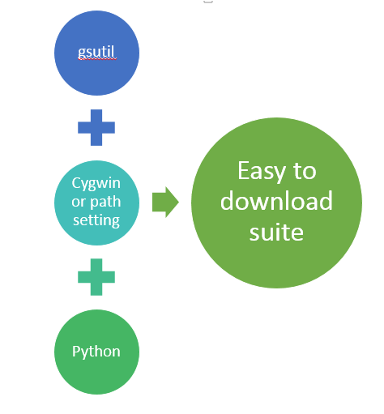
Installation Suggestion
Suggestion:
Have it bundle up into a suite
Or a PIP
Need clear instruction for log in: What to do to log in?
What is authorization code?
Notes:
PIP (Python manager program where you can just type pip install and it will download and install for you automatically.)

Slide 31
Output/Messages
Verification:
Verify if they logged in and finish a task
Message Output/ Feedback:
Need useful feedback
Notes:
Verification: Participants found they need to work on verification of finishing a task or for logged in.

Slide 32
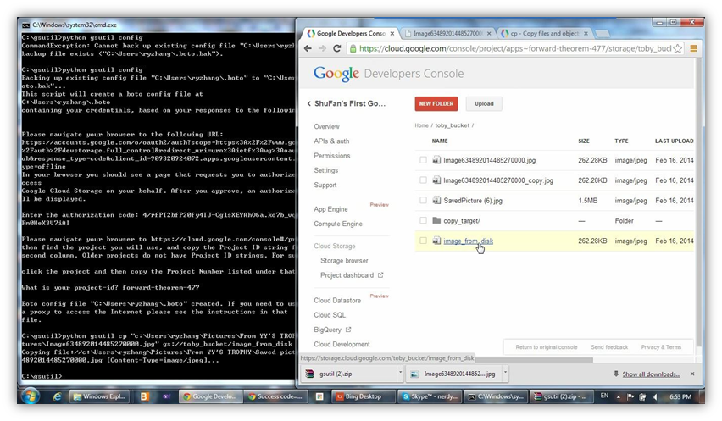
Output/Messages
No Feedback at all
Notes:
Participants constantly go back to Console to verify if they finish task or not

Slide 33
Output/Messages
“The error message
is useless...” P2

Slide 34
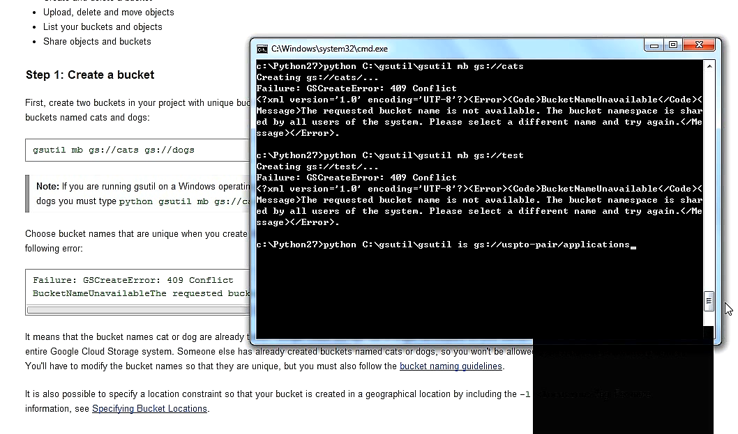
User’s Feedback
”Not sure if logged in”
“Not sure if logged in”

Slide 35
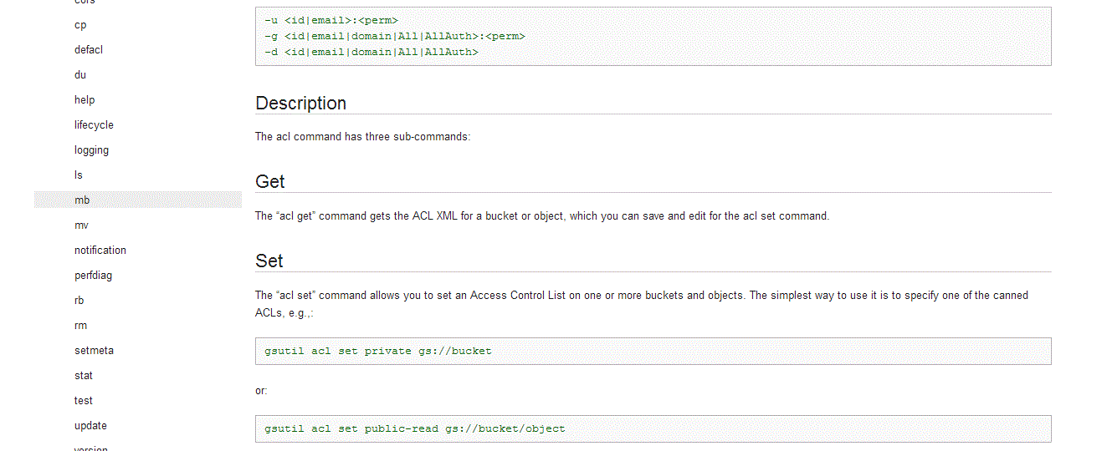
Documentation
.
Online Tutorial by examples
No indication of where the user is.
By Commands
Felt “annoyed” to go outside of the tool and on the Web to look for information
Felt “annoyed” to go outside of the tool and on the Web to look for information.
Felt “annoyed” to go outside of the tool and on the Web to look for information.
Disliked documentation
What is “Private”?
Notes:
Sample tutorials online for using simple tasks, e.g. Login, Create/Delete buckets.
Instructions are not clear, e.g copy of a file, and it is written in the context of developers.
Can’t find documentation on authorization code for Login.
ACL is not clear on the instruction
Searched online for ACL command instead of using gsutil
Terminology confusion, e.g. “bucket”.
Guideline is confusing and complicated
Too much descriptions and no examples of command line.
Tricky to copy/paste in command line. Should tell how.
Have video tutorial for instructions
Login instructions are too long and tedious to read, not helpful.

Slide 36
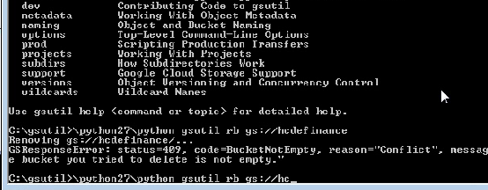
Configuration
Language
It should have standard language within command line world.
The tab should mirror UI with the command line
Delete
If the bucket is not empty,
user cannot delete the bucket.
Requires user to delete every item
in the bucket in advance.
“It's time consuming” (P8)
“repetitive, feel tedious” (P6)
Notes:
User required to delete every item in the bucket to accomplish task.
Information given as a safety issue that Google wants to make sure everything is deleted before deleting the bucket but current process is time consuming.

Slide 37
User’s Feedback
” “Would need to hire an intern.”

Slide 38
Configuration: system configuration
Copy Links, Project ID, and URL
Copy URL from command browser is hard to complete is cumbersome
“A lot of back and forth to copy link and project ID to the browser.” (P4)
Notes:
PIP (Python manager program where you can just type pip install and it will download and install for you automatically.)

Slide 39
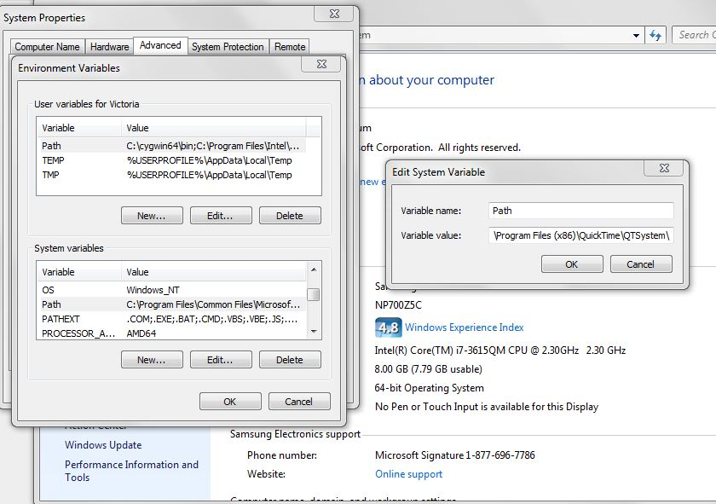
Configuration
Adding Path
Add path in command line is troublesome.
“It should be automated,
have it linked together;
though it could be a
Window's problem.”(P8)
Notes:
PIP (Python manager program where you can just type pip install and it will download and install for you automatically.)

Slide 40

Wrap up
Expectation vs Satisfaction
5E’s of Usability
SUS
Recommendation
Overall Recommendation
Lessons Learned
Next Steps

Slide 41
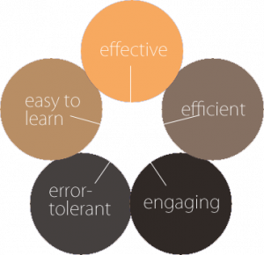
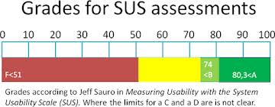
Expectation vs Satisfaction
Comparison of Expectations Before/After Tasks
5E’s of Use
It is a simple method to gauge and visualize the balance of needs for each dimension and help with actionable recommendations
Systems Usability Scale
SUS is a simple, widely used 10-statement survey
Notes:
Gauge to bring together expectation and knowledge about the users.
* Participants provided insights on a scale of 1-5*, for each E, and often gave additional comments.
* We gauged prior assumptions and an after task assessment as a gauge on Developer Console tasks and the gsutil tasks.
http://www.wqusability.com/articles/getting-started.html
Whitney Quesenbery's 5 Es of Use
Effective: How completely and accurately the work or experience is completed or goals reached
Efficient: How quickly this work can be completed
Engaging: How well the interface draws the user into the interaction and how pleasant and satisfying it is to use
Error Tolerant: How well the product prevents errors and can help the user recover from mistakes that do occur
Easy to Learn: How well the product supports both the initial orientation and continued learning throughout the complete lifetime of use

Slide 42
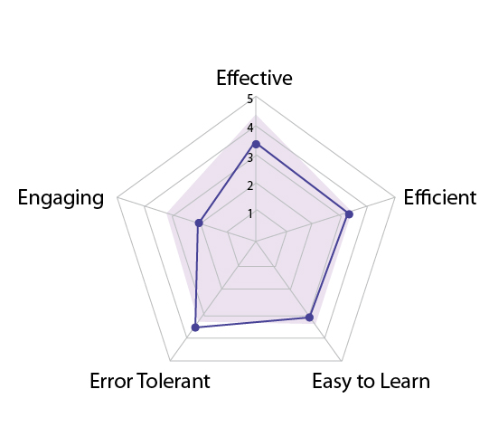
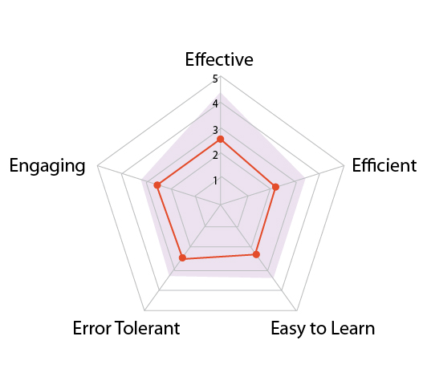
5E’s of Usability
Expectation score before gsutil task sections and comparison scores after gsutil task section experiences
.
Developer Console
gsutil
* Gray = Pre-expectation before task/ Line = Satisfaction after task / 1 = low not E / 5 = high very E
Notes:
*Will mention not statistically robust.

Slide 43
Systems Usability Scale (SUS)
.
SUS
P1(pilot test) n/a
P2: 45
P3: 37.5
P4: 45
P5: 47.5
P6: 62.5
P7: 37.5
P8: 35
44.3
1 quote from SUS

Slide 44
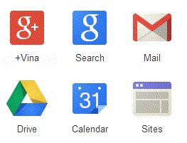

Recommendation - General Suggestion
.
Google Like Products
Save/Copy/Paste/Click/Design, etc.
Project Dashboard
Beta/Trails
Or, how free would be incentive to use.
Videos
"Download should work like gmail for console." (P8) "Be more like gdrive on how to use for example copy and paste"
Notes:
Functionality
Command line errors need to provide more details in explaining errors so can fix.
Focus on task completion over building engaging attributes.
Like Google Products
Commonality desired with Google products (gmail, gdrive) for copy, paste, snap and drag, right click, and layout design.
Data functions such as save, need to be quick to deploy.
"Layout, click and drag, save and use right click setup should be similar to other google products" (P3) 5E's & Q1
Trial Offering
Product does “not offer guest login”
Suggest “offer free trial” or limited data size, “500 gigabytes for storage to evaluate initial entry.”
Project Dashboard
Provide a project dashboard with definitions, guides, and documentation to lessen recall use for content discoverability.

Slide 45
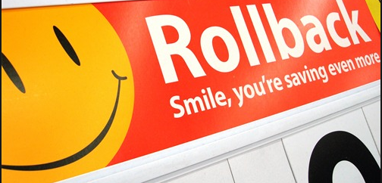
Recommendation - General Suggestion
"Walmart pricing structure would help with marketing these services."
Pricing
• Five users shared price important comparison with other products.
Indicated desire to pay less than others.
• Suggest take the Walmart undercut policy approach
Project Dashboard
Billing
• Provide examples and information on cost structure understand cost impacts
and see visible values.
• Billing links that show real-time ticker as funds accrue.
Notes:
Rollback link: http://dealarchitect.typepad.com/.a/6a00d8345190da69e20115706c8bb7970b-pi
Active billing links as costs accrue like a pay ticker.
Showcase advantages, “store large files at a low price,” share in a visible location.
"Request to see more information and examples for billing." (P3 & P4) "Wants billiing links, a tab that shows an acrue of funds as they occur, basically bill real-time ticker." (P6) Q1

Slide 46
Recommendation - Console
.
Priority | Product Area | Category | Subcategory
P1 | Functionality | User Interaction | · Fix Overview page to display correct information and unblock users from other pages. · Add mapping hierarchy to the file structure and design layout. · State Message: Show message displays of user actions
P1 | Documentation | Terminology and Nomenclature | · Clarify on the usage of ProjectID, Object Permission, and Private · Add definitions for these terms and use consistent terms for the names. · Add online Help and examples on how-to use the Console
Notes:
Redefine Overview section to display information about the product/tool.
Nomenclature consistency and locatability to terminology (drop downs) and tutorials.
Fix Permission with clearer definition and explanation of what this feature is.
gsutil
Instructions on path + verify the process

Slide 47
Recommendation - gsutil
Priority | Product Area | Category | Subcategory
P1 | Installation | Paths/Software Requirements | · Add an installer package to autogenerate paths, create shortcuts, etc for setup · Provide visible and direct links for correction Python version installation
P1 | Output/Messages | Message Output | · Inform users of input attempts · Parse long message outputs to be readable
P1 | Documentation | Online Tutorial | · Fix online tutorial with examples · Fix Help & FAQ sections to contain clearer steps for using the tool · Fix instructions for installation, consistent naming, and on basic cmds
P1 | Configuration | Command Functionality | · Fix delete to be able to do bulk delete at the bucket level, instead of at file level · Fix command language to be standard commands as other command tools · Fix easier steps to login and authentication on the o E.g. remove Authentication code from UI, etc.
Notes:
Redefine Overview section to display information about the product/tool.
Nomenclature consistency and locatability to terminology (drop downs) and tutorials.
Fix Permission with clearer definition and explanation of what this feature is.
gsutil
Instructions on path + verify the process

Slide 48
User’s Feedback
“ I know it is not a test about me,
but I feel that I was in a job interview.”
Notes:
Important that we are testing the product and not the users knowledge - lesson learned to stay focused and reassure participant. Use as a lead into Lesson’s Learned.

Slide 49
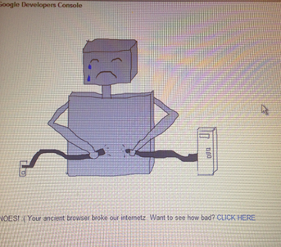
Lessons Learned
Tools and Equipment
• Software-Morae
- Issues with video and audio
- Lack of consistent face captures.
• Hardware - Old PC (LUTE)
- Broken system
- Administrative Rights
Time to Task/Completion
• Tasks overload.
• Task questionnaires too long
Data Analysis
• Huge amount of data to evaluate
in short duration
- Methods of data breakdown.
Affinity diagram
Notes:
Important that we are testing the product and not the users knowledge - lesson learned to stay focused and reassure participant. Use as a lead into Lesson’s Learned.

Slide 50

Next Steps
.
Pricing
• Polish data and review findings with client
• Possible opportunity to present to Google’s product teams.

